Slide 1
Advanced higher Graphic communication
Simulation, FEA and CFD

Slide 2
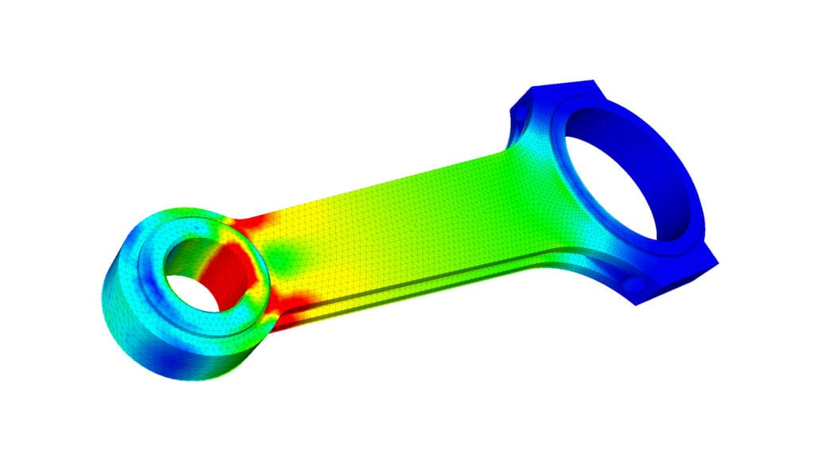
Finite element analysis
FEA; What is it?
Finite element analysis (FEA) is a computerised method for predicting how a product reacts to real-world forces, vibration, heat, fluid flow, and other physical effects.
Finite element analysis shows whether a product will break, wear out, or work the way it was designed. It is called analysis, but in the product development process, it is used to predict what is going to happen when the product is used. Finite element analysis helps predict the behaviour of products affected by many physical effects, including:
  Mechanical stress
  Mechanical vibration
  Fatigue
  Motion
  Heat transfer

Slide 3
Finite element analysis (cont)
In FEA a ‘load’ is often applied to a product to test whether or not it can withstand the maximum weight that it could potentially bear when in use. A good example of this is a bridge. Digital tests can determine the strength of the bridge when loaded at its full capacity (possibly during rush hour) and whether or not the structure would be safe and fully functional when at maximum load.
Conducting tests on products can highlight high levels of stresses and strains on weaker sections of the product which could potentially lead to failures. Structures can be reinforced after testing to strengthen the structure. Webs are commonly added to reinforce weak areas of a structure.

Slide 4
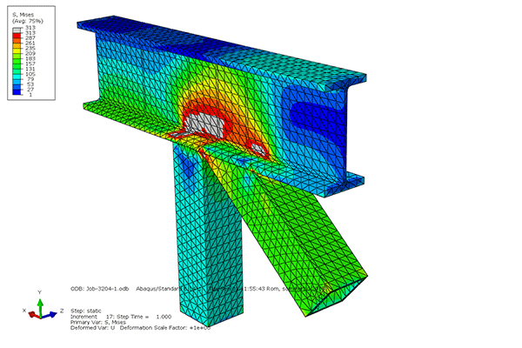
Finite element analysis (cont)
Set-Up Requirements for FEA
Apply Materials to the model.
Apply constraints or fixing points to the model.
Apply forces or loads onto the model I the correct location.
Specify environmental conditions (e.g. Temperature)
Select scale of units to achieve clearest visual results

Slide 5
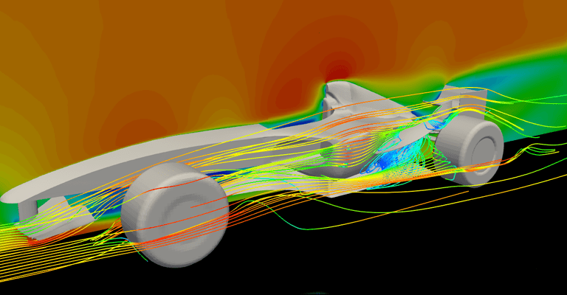
Computational fluid dynamics
CFD, What is it?
CFD is a form of digitally testing the airflow through the internals of a building or through or over a product. It is of benefit for the following reasons.
  It is a cost effective way of improving internal/external building design.
  The use of CFD can increase building design performance by establishing how the air flow through rooms is going to affect the people working/living in that area.
  It could be used to establish where to locate various furniture, heating systems, height of ceilings, etc.

